Slide 1
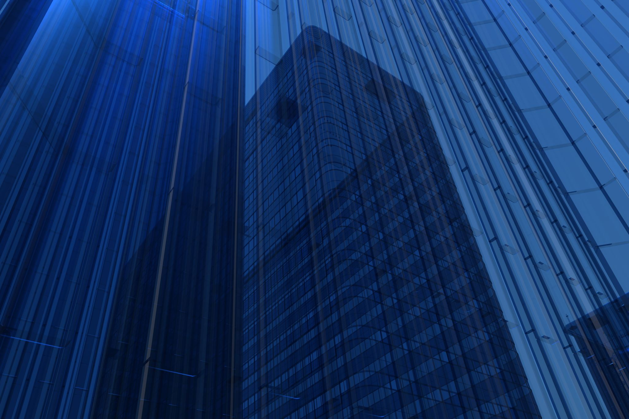
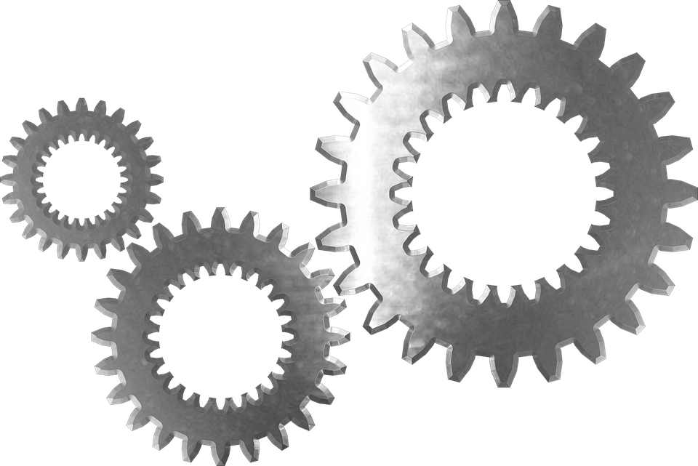
IDEA PICHING OF GROUP PROJECT
October 24, 2023
Team 09

Slide 2

Agenda
Introduction
Team
Ideas of each group members
Pugh chart classification
Comprehensive project idea

Slide 3
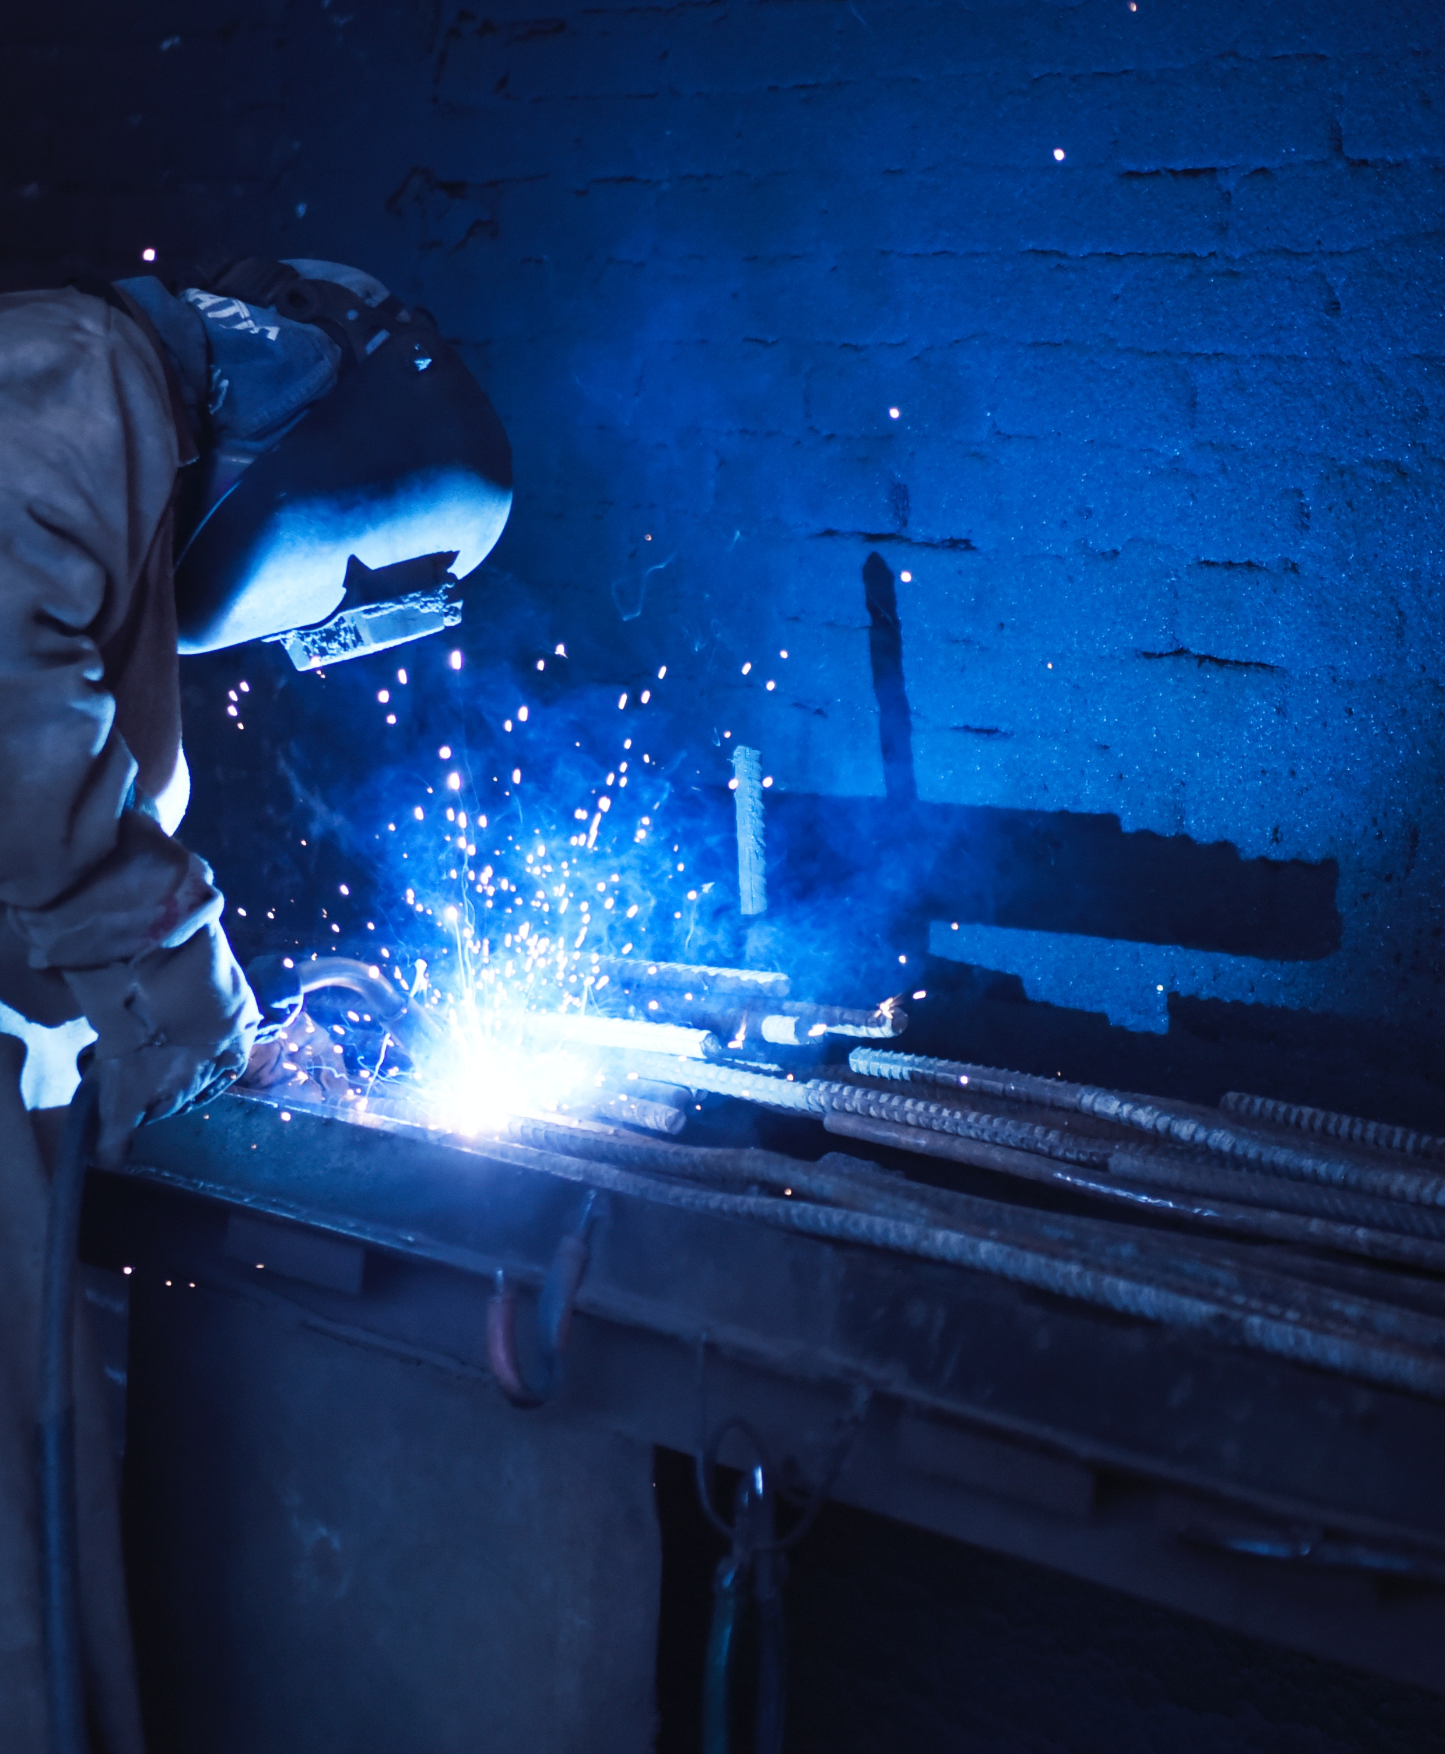
Introduction
This presentation is mainly focused in idea pitching of each group member and we try to choose one of the best product that can be make from these ideas from classified in different criteria.

Slide 4




Team
P.D.S.CHAMARA
22/ENG/112
N.L.SENDANAYAKA
22/ENG/109
L.Y.A.INDUSARA
22/ENG/091
R.A.R.W.RUPASINGHE
22/ENG/134

Slide 5


Ideas of each group member
22/ENG/112
Height adjustable chair
Drum set
Chair as a bed
Metal toy jeep
Flower pots stand
Basket hanger
Tin cutter
Metal watering can
Simple engine
Rotatable table
22/ENG/109
Metal hammer
Iron clamp
Bottle opener
Small items holder
Dinosaur model
Home fire pit
Metallic dress
Metallic helmet
Dustbin
Wall décor
22/ENG/091
Push button tap
Adjustable scissor
Laptop stand
Compost bin
Mechanical lock
Shower head
Adjustable luggage
Wheel barrow
Metal cup
Adjustable table
22/ENG/134
Toy truck
Toy bicycle
Ladder
Metal clamp
Metal bucket
Door latch
Steel funnel
Metallic pen
Necklace
Knife

Slide 6
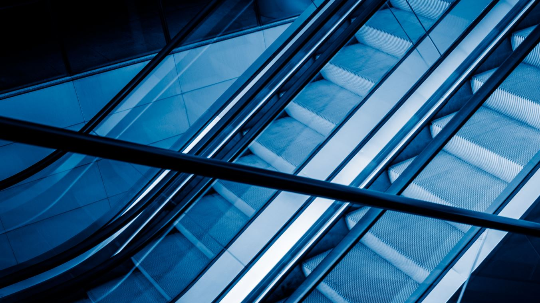
Pugh chart classification
I created a Pugh chart using my ideas and I selected the metal watering can for our creative product.
22/ENG/112 |  | 1 | 2 | 3 | 4 | 5 | 6 | 7 | 8 | 9 | 10
Durability |  | + | 0 | + | - | + | 0 | - | + | + | +
Cost |  | - | + | - | - | + | - | - | + | - | +
Creativity |  | + | + | + | + | - | - | + | 0 | + | +
Social impact |  | + | + | - | + | - | - | - | 0 | - | 0
Feasibility |  | 0 | 0 | 0 | 0 | 0 | + | + | + | + | +
Safety |  | + | 0 | + | 0 | + | + | + | + | 0 | -
+ |  | 4 | 3 | 3 | 2 | 3 | 2 | 3 | 4 | 3 | 4
0 |  | 1 | 3 | 1 | 2 | 1 | 1 | 0 | 2 | 1 | 1
- |  | 1 | - | 2 | 2 | 2 | -3 | 3 | 0 | 2 | -1
Total points |  | 3 | 3 | 1 | 0 | 1 | -1 | 0 | 4 | 1 | 3
weight

Slide 7
22/ENG/109 |  | 1 | 2 | 3 | 4 | 5 | 6 | 7 | 8 | 9 | 10
Durability |  | + | + | 0 | + | + | + | + | + | + | +
Cost |  | 0 | 0 | - | + | - | - | - | 0 | + | +
Creativity |  | 0 | + | 0 | - | + | - | + | 0 | - | +
Social impact |  | - | - | 0 | - | - | 0 | - | 0 | 0 | 0
Feasibility |  | + | + | + | 0 | 0 | + | - | + | 0 | 0
Safety |  | 0 | 0 | + | + | 0 | 0 | - | + | 0 | +
+ |  | 2 | 3 | 2 | 3 | 2 | 2 | 2 | 3 | 2 | 4
0 |  | 3 | 2 | 3 | 1 | 2 | 2 | 0 | 3 | 3 | 2
- |  | 1 | 1 | 1 | 2 | 2 | 2 | 4 | - | 1 | -
Total points |  | 1 | 2 | 1 | 1 | 0 | 0 | -2 | 3 | 1 | 4
I created a Pugh chart using my ideas and I selected the wall decor for our creative product.
weight

Slide 8
22/ENG/091 |  | 1 | 2 | 3 | 4 | 5 | 6 | 7 | 8 | 9 | 10
Durability |  | 0 | + | + | + | + | 0 | + | + | 0 | +
Cost |  | + | + | - | 0 | + | + | - | - | + | +
Creativity |  | - | - | + | 0 | - | - | + | 0 | - | +
Social impact |  | 0 | 0 | + | - | - | - | + | 0 | 0 | +
Feasibility |  | + | + | + | 0 | + | + | 0 | + | 0 | +
Safety |  | + | + | + | + | + | 0 | 0 | + | - | +
+ |  | 3 | 4 | 5 | 2 | 4 | 2 | 3 | 3 | 1 | 5
0 |  | 2 | 1 | - | 3 | - | 2 | 2 | 2 | 3 | -
- |  | 1 | 1 | 1 | 1 | 2 | 2 | 1 | 1 | 2 | -
Total points |  | 2 | 3 | 4 | 1 | 2 | 0 | 2 | 2 | -1 | 5
I created a Pugh chart using my ideas and I selected the adjustable table for our creative product.
weight

Slide 9
22/ENG/134 |  | 1 | 2 | 3 | 4 | 5 | 6 | 7 | 8 | 9 | 10
Durability |  | + | + | + | + | + | + | 0 | + | 0 | +
Cost |  | - | - | - | + | + | + | + | - | + | +
Creativity |  | + | + | 0 | - | - | - | 0 | + | 0 | -
Social impact |  | + | + | + | + | + | 0 | 0 | 0 | 0 | -
Feasibility |  | 0 | 0 | + | + | + | + | + | + | - | +
Safety |  | + | + | + | + | + | + | 0 | 0 | - | 0
+ |  | 4 | 4 | 4 | 5 | 5 | 4 | 2 | 3 | 1 | 3
0 |  | 1 | 1 | 1 | - | - | 1 | 4 | 2 | 3 | 1
- |  | 1 | 1 | 1 | 1 | 1 | 1 | - | 1 | 2 | 2
Total points |  | 3 | 3 | 3 | 4 | 4 | 3 | 2 | 2 | -1 | 1
I created a Pugh chart using my ideas and I selected the metal bucket for our creative product.
weight
Adjustable chair is a best idea from looking at our main top four ideas. So, we like to make it correctly.

Slide 10
Key features of the adjustable table
Length adjustable
Height adjustable
Easy to carry
Multiple works
Strong

Slide 11

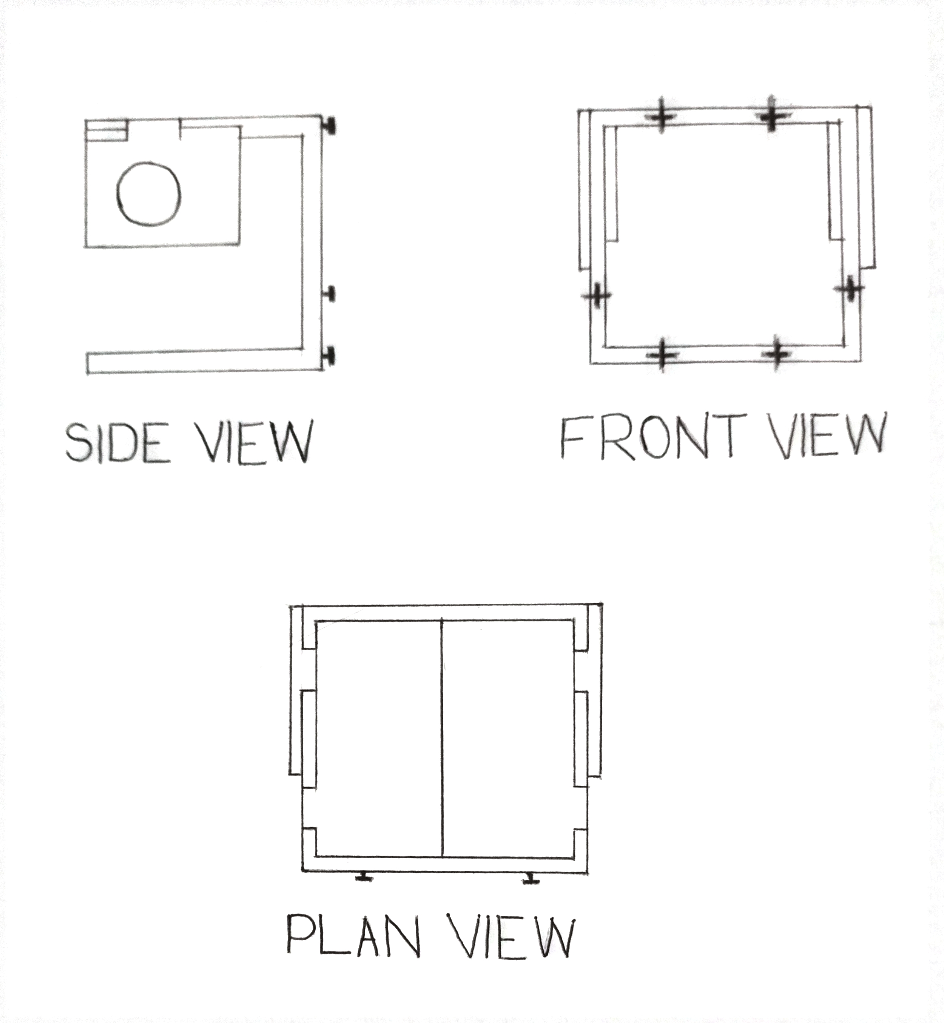
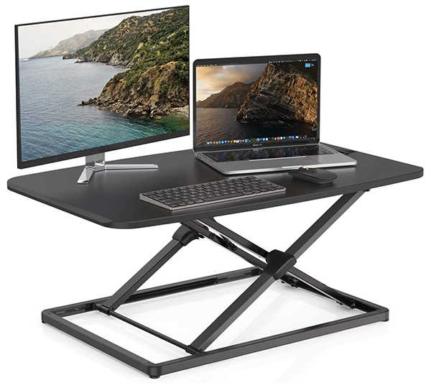
Hand drawn diagram

Slide 12

Cost estimation
Stainless steel box bar 108” = Rs. 900 (width = 0.5”)
108” = Rs.1100 (width = 1.0”)
Welding sticks 400g = Rs. 500
Wood 1m^2 = Rs. 500
Metal sheets 1m^2 = Rs. 500
Total cost = Rs.3500

Slide 13


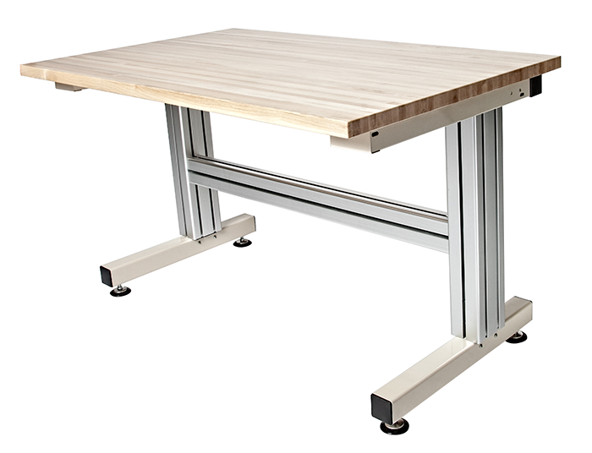
ADJUSTABLE TABLE
THE PERFECT UPGRADE FOR YOUR ;
HOME
OFFICE
READING AREA
WORK STATION
HEIGHT RANGES:< 24”- 48” >
PRICE:< Rs.5,000 >
Heavy duty steel base
Scrach resistant work surface
3% DISCOUNT FOR DEBIT CARDS
ISLAND WIDE FREE DELIVERY

Slide 14


